Slide 1
HealthApp
Team 4:
Tarun Dagar
Jigarkumar Patel
Riddhi Mhatre
Vivek Karhale
Sriharsha Mopidevi
Fernando Hernández
Aliaksandra Paliashchuk
Nishith Desai

Slide 2
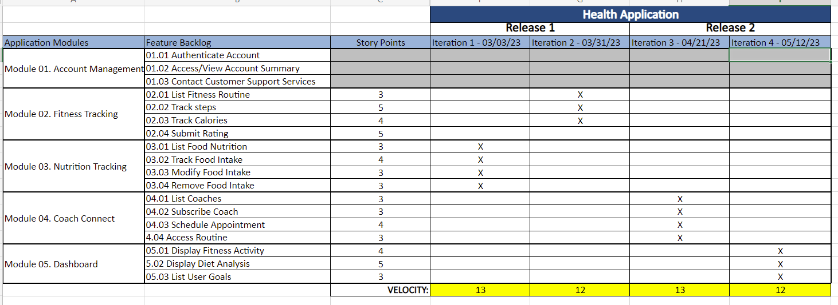
Road MaP– Tarun Dagar

Slide 3
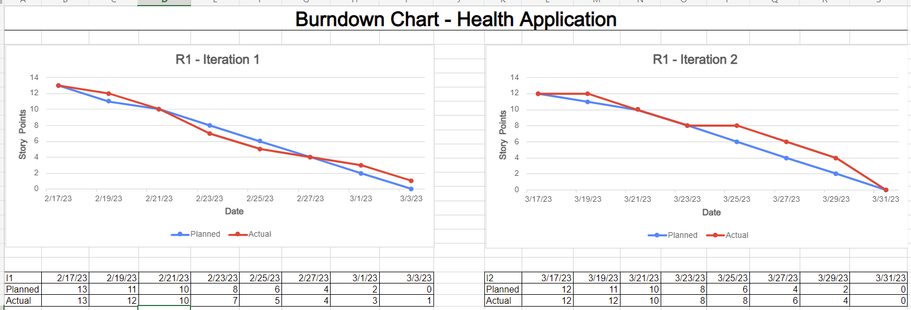
burn down chart - Fernando Hernández

Slide 4
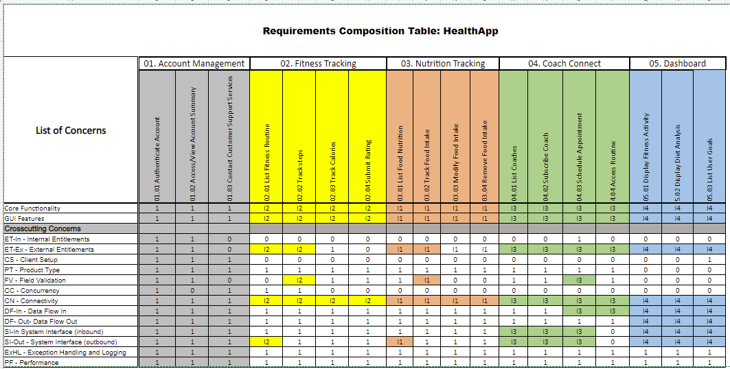
Rct - Aliaksandra Paliashchuk

Slide 5
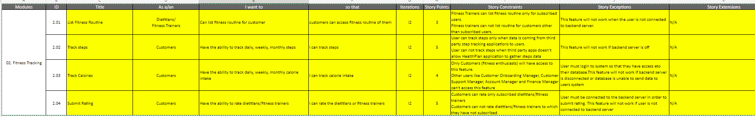
User stories- Vivek
Modules | ID | Title | As a/an | I want to | so that | Iterations | Story Points | Story Constraints | Story Exceptions | Story Extensions
03. Nutrition Tracking | 3.01 | List Food Nutrition | Dietitians/ Fitness Trainers/ Customer Onboarding Manager/ Customer Support Manager | Can list all the foods | I can see food intake and nutritional values of food | I1 | 3 | Only dietitians/fitness trainers can list food nutrition. Customers(fitness enthusiast) can not list it. | This feature will not work when the user is not connected to backend server. | N/A
 | 3.02 | Track Food Intake | Customers | Have the ability to track daily, weekly, monthly food intake | I can track details of food intake | I1 | 4 | This feature will be only available to customers (fitness enthusiast). Other users like Customer Onboarding Manager, Customer Support Manager, Account Manager and Finance Manager can't access this feature | User must login to system so that they have access eto their database.This feature will not work if backend server is disconnected or database is unable to send data to users system | N/A
 | 3.03 | Modify Food Intake | Customers | Have the ability to modify food intake user already entered | I can modify food item as well as quantity of food entered | I1 | 3 | Only Customers (fitness enthusiasts) will have access to this feature. Other users like Customer Onboarding Manager, Customer Support Manager, Account Manager and Finance Manager can't access this feature | User must login to system so that they have access eto their database.This feature will not work if backend server is disconnected or database is unable to send data to users system | N/A
 | 3.04 | Remove Food Intake | Customers | Have the ability to remove food intake | I can delete entry of food item entered | I1 | 3 | Only Customers (fitness enthusiasts) will have access to this feature. Other users like Customer Onboarding Manager, Customer Support Manager, Account Manager and Finance Manager can't access this feature | This feature will not work if backend server is disconnected or database is unable to send data to users system | N/A

Slide 6
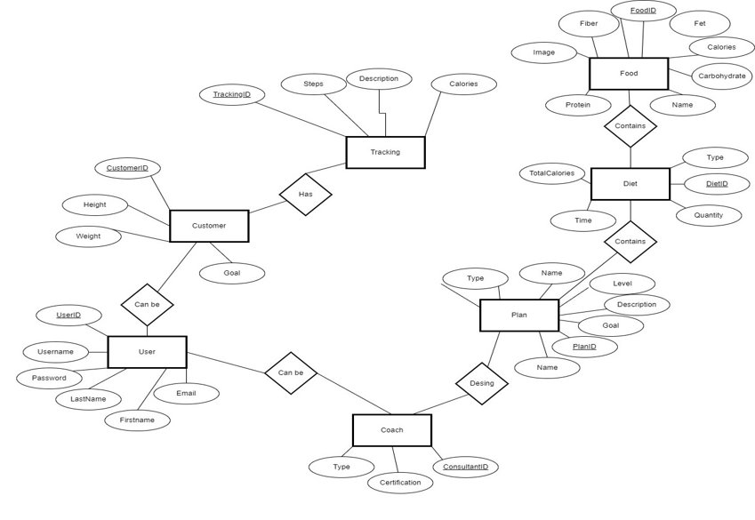
ER Diagram – Jigarkumar patel Logical ER Diagram​​– I1 Scope​ Health Application​

Slide 7
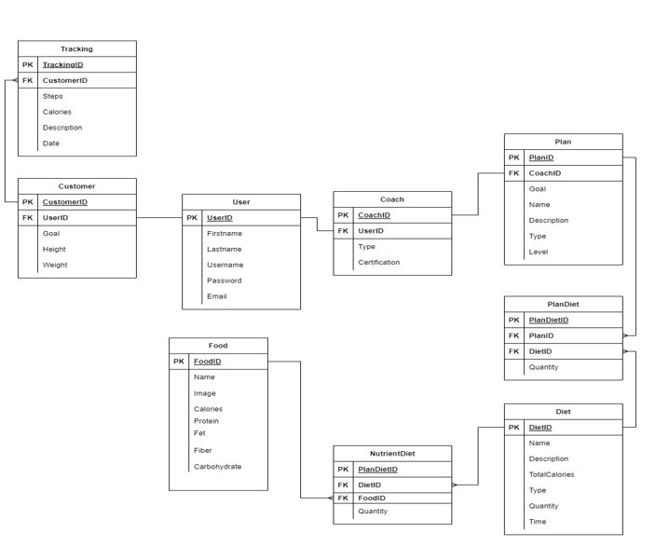
Logical ER Diagram​​– I1 Scope​ Health Application​

Slide 8
Acceptance Tests –Riddhi

Slide 9
Test execution log - Nishith
Test Set | Test Case Title | Status | Exec. Date | Tester's Name
Iteration 1 | TC1. Track Food intake - GUI Features Testing | No Run | 2/00/2023
Iteration 1 | TC2. Track Food intake - Core Functaionality Testing | No Run | 2/00/2023
Iteration 1 | TC3. Track Food intake - Product Type | No Run | 2/00/2023
Iteration 1 | TC4. Track Food intake - Field Validation -Name /Account Number /CVV/Exp Date | No Run | 2/00/2023
Iteration 1 | TC5. Track Food intake - Connectivity | No Run | 2/00/2023
Iteration 1 | TC6. Track Food intake - Data Flow In | No Run | 2/00/2023
Iteration 1
Iteration 1
Test Set | Test Case Title | Status | Exec. Date | Tester's Name
Iteration 1 | TC1. List Food Nutrition - Core Functaionality Testing | No Run | 2/00/2023
Iteration 1 | TC2. List Food Nutrition - GUI Features Testing | No Run | 2/00/2023
Iteration 1 | TC3. List Food Nutrition- Product Type | No Run | 2/00/2023
Iteration 1 | TC4. List Food Nutrition - Field Validation - Add weight | No Run | 2/00/2023
Iteration 1 | TC5. List Food Nutrition - Field Validation - Add Search Box | No Run | 2/00/2023
Iteration 1 | TC6. List Food Nutrition - Connectivity | No Run | 2/00/2023
Iteration 1 | TC7. List Food Nutrition - Data Flow In | No Run | 2/00/2023

Slide 10
Test Set | Test Case Title | Status | Exec. Date | Tester's Name
Iteration 1 | TC1. List Food Nutrition - Core Functaionality Testing | No Run | 2/00/2023
Iteration 1 | TC2. List Food Nutrition - GUI Features Testing | No Run | 2/00/2023
Iteration 1 | TC3. List Food Nutrition- Product Type | No Run | 2/00/2023
Iteration 1 | TC4. List Food Nutrition - Field Validation - Add weight | No Run | 2/00/2023
Iteration 1 | TC5. List Food Nutrition - Field Validation - Add Search Box | No Run | 2/00/2023
Iteration 1 | TC6. List Food Nutrition - Connectivity | No Run | 2/00/2023
Iteration 1 | TC7. List Food Nutrition - Data Flow In | No Run | 2/00/2023
Iteration 1 | TC8.Modify Food Intake - Data Flow Out | No Run | 2/00/2023
Iteration 1 | TC9. Modify Food Intake - Inbound system interface and Outbound System Interface | No Run | 2/00/2023
Test Set | Test Case Title | Status | Exec. Date | Tester's Name
Iteration 1 | TC1.Remove Food intake - GUI Features | No Run | 2/00/2023
Iteration 1 | TC2.Remove Food intake - Core Features | No Run | 2/00/2023
Iteration 1 | TC3.Remove Food intake - Product Type | No Run | 2/00/2023
Iteration 1 | TC4.Remove food intake - Connectivity | No Run | 2/00/2023
Iteration 1 | TC5.Remove Food intake - Data Flow In and out | No Run | 2/00/2023

Slide 11

Jenkins Demo-Tarun dagar
https://paceuniversity-my.sharepoint.com/personal/vk77333n_pace_edu/_layouts/15/onedrive.aspx?csf=1&web=1&e=2hSdRy&cid=8a71460d%2Da666%2D4c06%2Da234%2D20d92347a313&FolderCTID=0x0120009C52753C321D544A87773635E9751913&id=%2Fpersonal%2Fvk77333n%5Fpace%5Fedu%2FDocuments%2FTeam%204%20Health%20Plan%2FAll%20Doc%20Pre%203%2E3%2F14a%2E%20R1%5FJenkins%20Demo%5FTeam%204%2Emp4&parent=%2Fpersonal%2Fvk77333n%5Fpace%5Fedu%2FDocuments%2FTeam%204%20Health%20Plan%2FAll%20Doc%20Pre%203%2E3

Slide 12
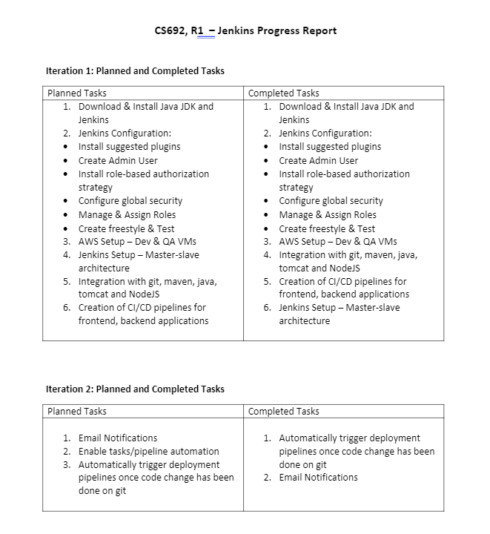
Jenkins progress report –Tarun dagar

Slide 13
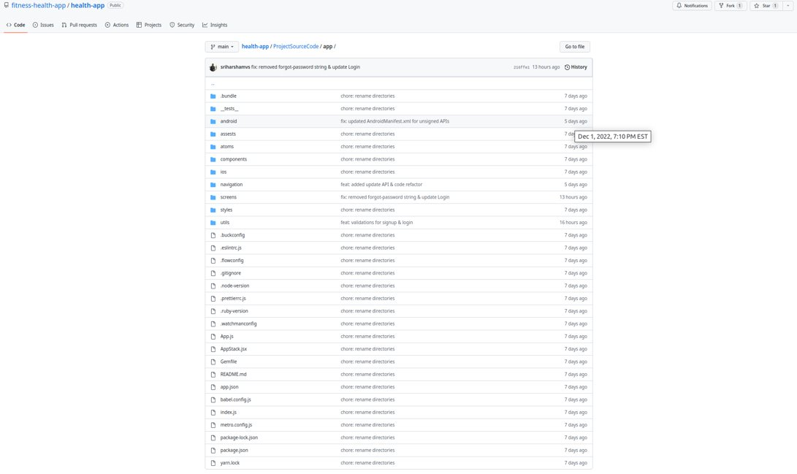
Source Code - Sriharsha Mopidevi

Slide 14
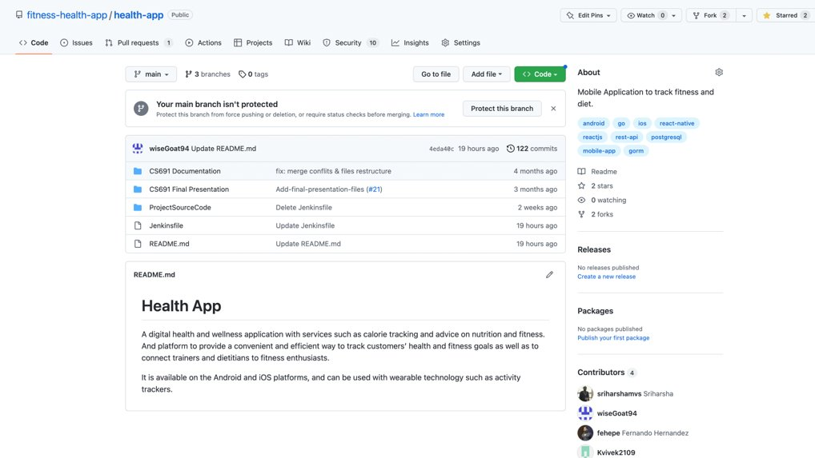
GIThub - Sriharsha Mopidevi

Slide 15
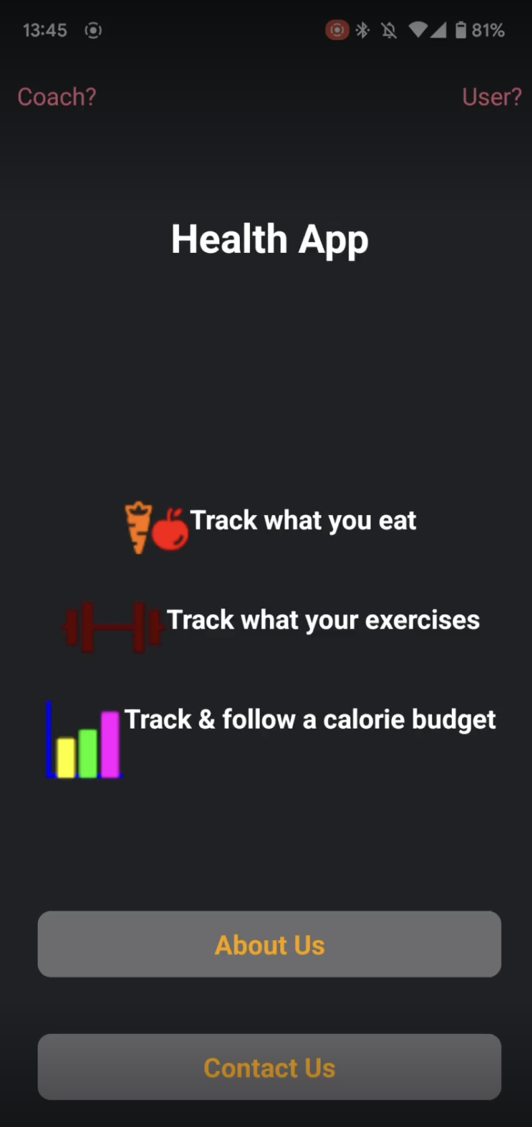
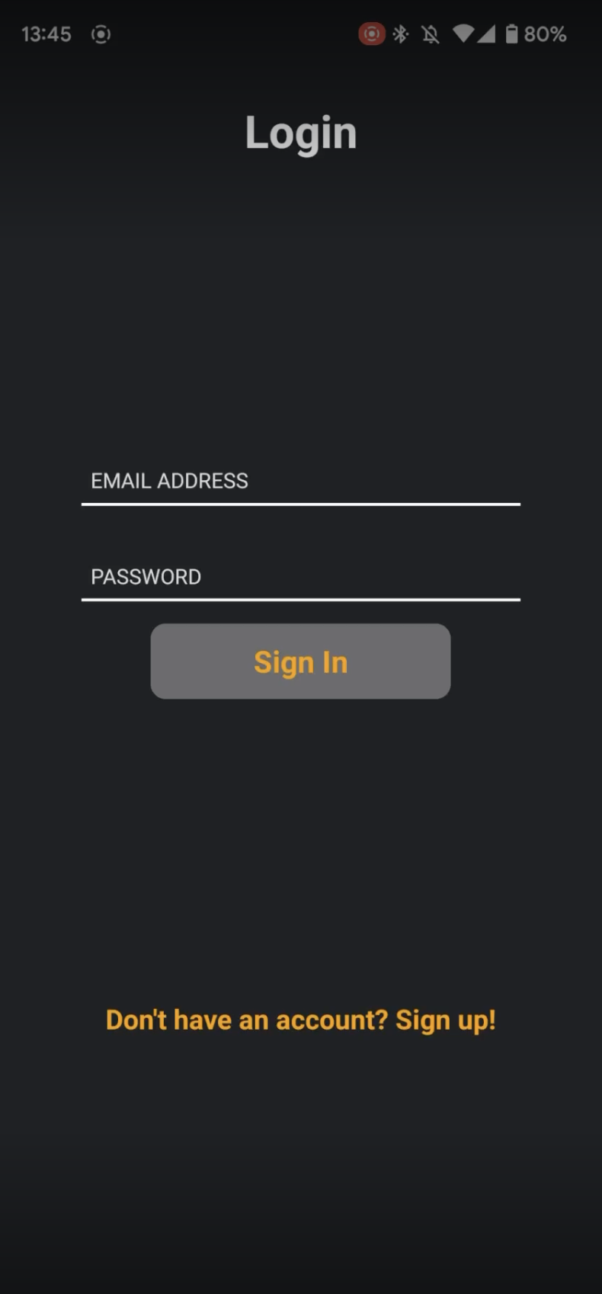
Application demo -sriharsha

Slide 16
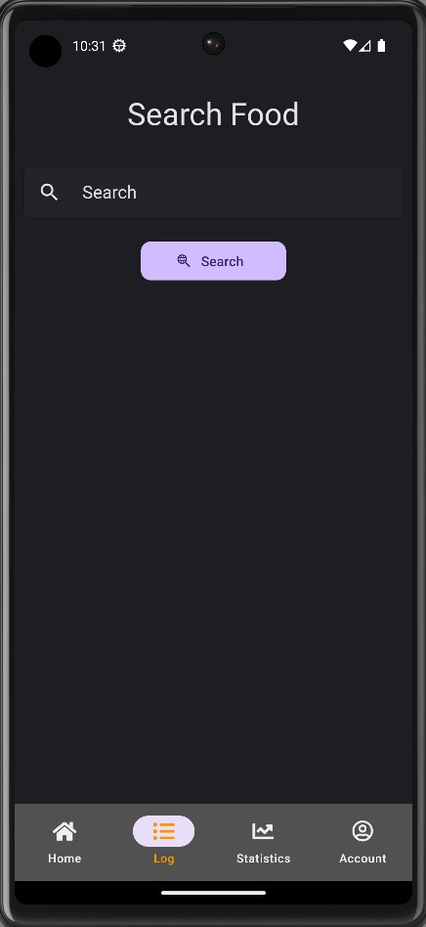
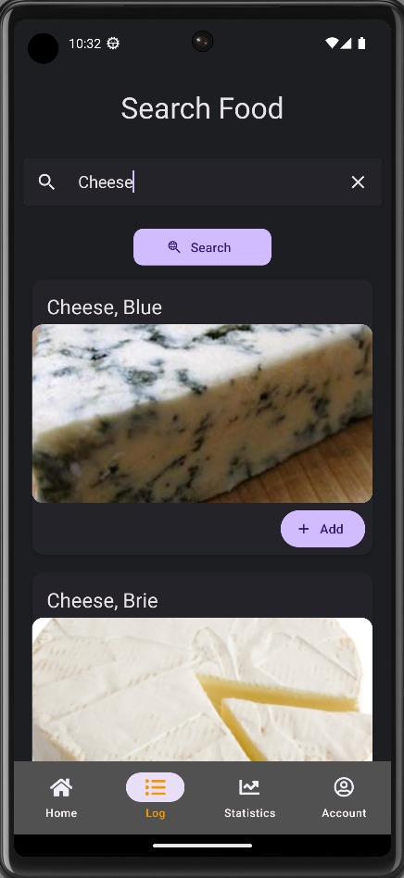

Slide 17
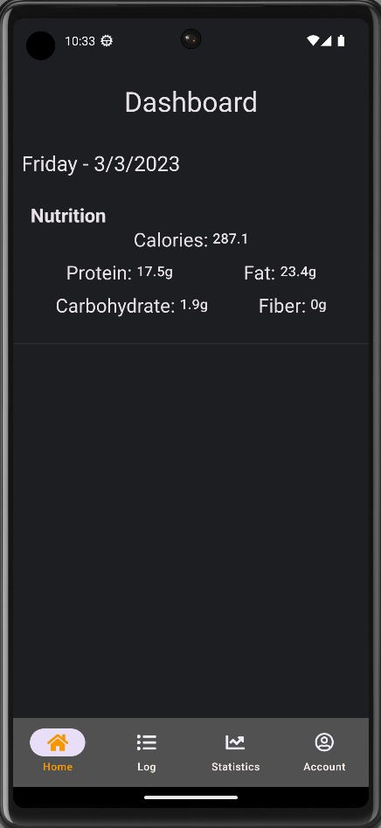
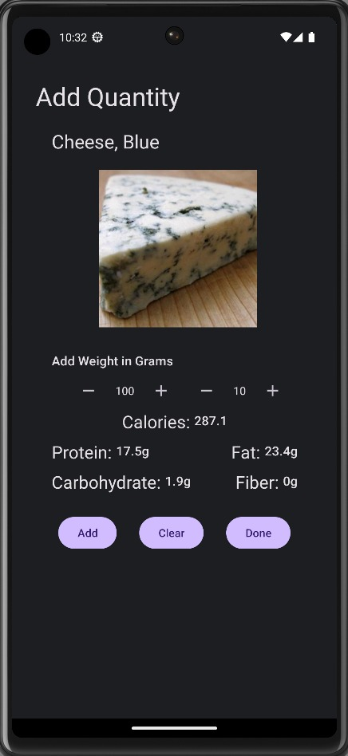

Slide 18
